Slide 1
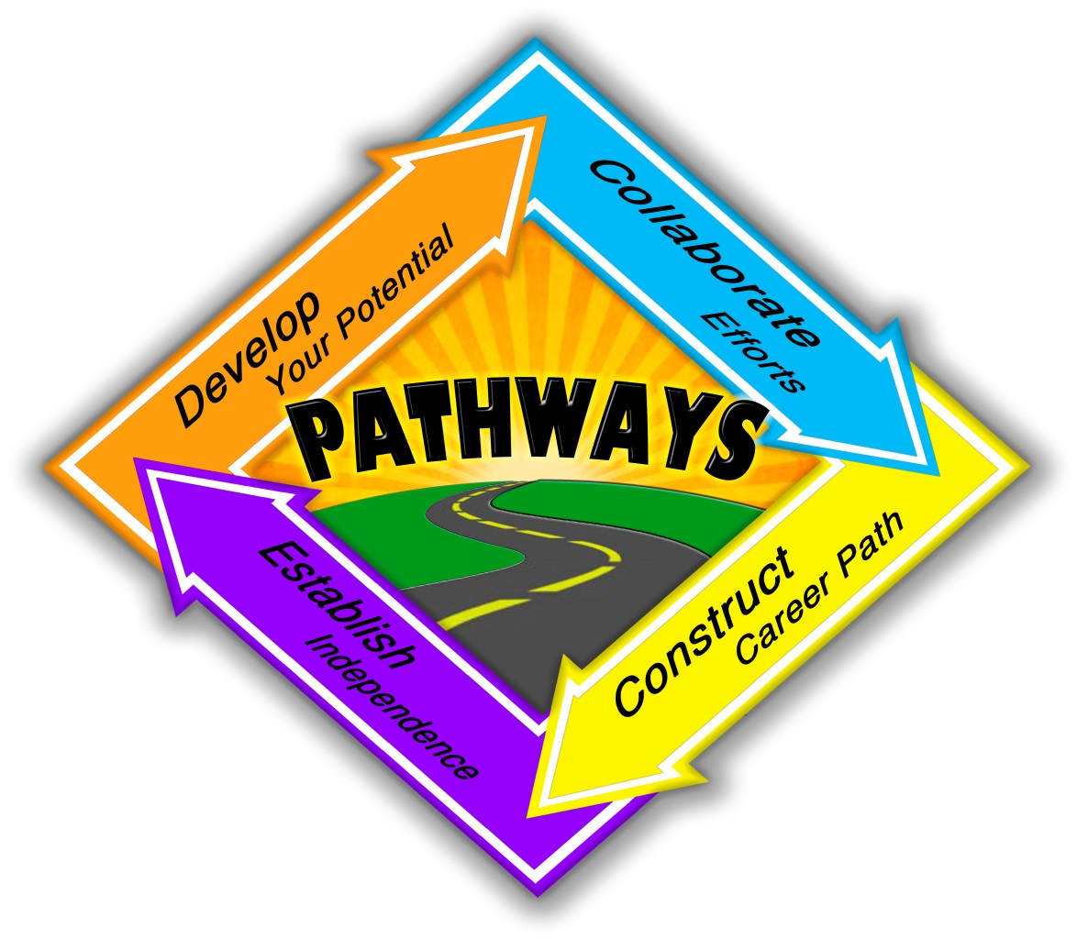
Pathways to Employment
Division of Developmental Disabilities
Services

Slide 2
What Is The Pathways Program??
Medicaid program assisting young adults with disabilities in accessing employment related services
Employment Navigators use a person-centered approach and a team process to meet the individuals needs and achieve goals
Notes:
Pathways targets transition age youth to build upon a strong foundation and investment of the education system, ensuring continued emphasis and support for employment during this critical time in the lives of the youth with disabilities.

Slide 3
Eligibility for Pathways
Individuals ages 14-25, who have a desire to work in a competitive work environment.
Be Medicaid Eligible and meet Certain financial eligibility.
Individuals with Intellectual and or Developmental Disabilities attributed to one or more of the following :
Adaptive scores of 2 standard deviations below the mean
Autism Spectrum Disorder
Asperger’s Syndrome
Prader- Willi Syndrome
Brain Injury or neurological condition related to IDD that originated before the age of 22.

Slide 4
Needs Based Criteria
If an individual does not have DDDS Services or does not qualify they must meet at least one of the following criteria:
Significant limitations in adaptive function
Assistance with at least one area of Activities of Daily Living (ADL)
Difficulty understanding and interpreting social situations
Notes:
Individuals with significant limitations in adaptive function and/or who need assistance with at least one area of Activities of Daily Living ( ADL) and/or who have difficulty understanding and interpreting social situations and who are unlikely to be able to obtain or sustain competitive employment without supports.

Slide 5
Services and Supports
Employment Navigation
Career Exploration & Assessment
Supported Employment
Benefits Counseling
Financial Coaching
Assistive Technology
Personal Care
Non-Medical Transportation

Slide 6
Employment Navigation
Performs initial assessments to develop employment plan
Connects individuals to employment services
Ensures employment supports and services are working together; monitors employment plan
Conflict-free

Slide 7
Career Exploration & Assessment
Person-centered employment planning services which helps individuals identify a career plan
Identifies jobs that match interests, abilities, and skills

Slide 8
Supported Employment
On the job support
Individual’s make minimum wage or better
Individual or small group (2-4)

Slide 9
Benefits Counseling
Work incentive counseling services
Provide tools to understand how to have a job and maintain benefits

Slide 10
Financial Coaching
Develop financial strategies identified through benefits counseling
Understand tax credits
Increase clients economic self-sufficiency

Slide 11
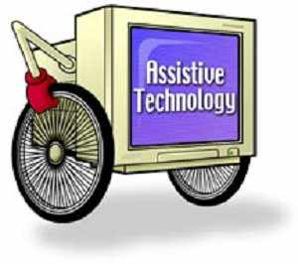
Assistive Technology
Evaluations and assessments to identify the clients needs
Select, acquire, and instruct to use device, etc.
Increases independence in the workplace

Slide 12
Personal Care
Assistance with ADL’s when getting ready for work or in the workplace
Services can be provided by a home health agency, a personal assistance services agency, or self-directed.

Slide 13
Non-Medical Transportation
Gain access to employment services, activities, and resources
Only when individual has no other means to work
Transportation Broker will arrange services

